Slide 1
Microsoft 365 overview
AFRICA’S DIGITAL FUTURE

Slide 2
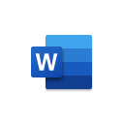
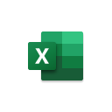
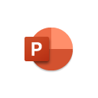
Microsoft 365 for business
Microsoft 365 Business Basic
Cloud services
Exchange
Teams
SharePoint
OneDrive
Microsoft 365 Business Standard
Cloud services and desktop apps
Exchange
Teams
SharePoint
OneDrive
Outlook
Word
Excel
PowerPoint
Publisher
Access
Microsoft 365 Business Premium
Cloud services, desktop apps, and advanced security
Exchange
Teams
SharePoint
OneDrive
Outlook
Word
Excel
PowerPoint
Publisher
Access
Intune
Azure Information Protection
Defender
Conditional Access
Windows Virtual Desktop
Note: Not all features/product logos shown.

Slide 3
Microsoft 365
Get more
done
Work better together
Build your business
Safeguard your data
Simplified for you
Notes:
What is Microsoft 365 Business Premium?
Microsoft 365 Business Premium is a complete integrated solution powered by Office 365 and Windows 10 designed to help you securely run and grow your business.
It brings together the best-in-class productivity capabilities of Office that enables you and your employees to create, connect and co-author from anywhere, any device while also providing you peace of mind through sophisticated security features to safeguard your business information from threats.
Microsoft 365 Business Premium also helps you grow your business through specific tools that help you interact and find new customers
With Microsoft 365 Business Premium you have one subscription that enables collaboration, has tools that help you grow your business while providing you peace of mind by safe guarding your business information

Slide 4
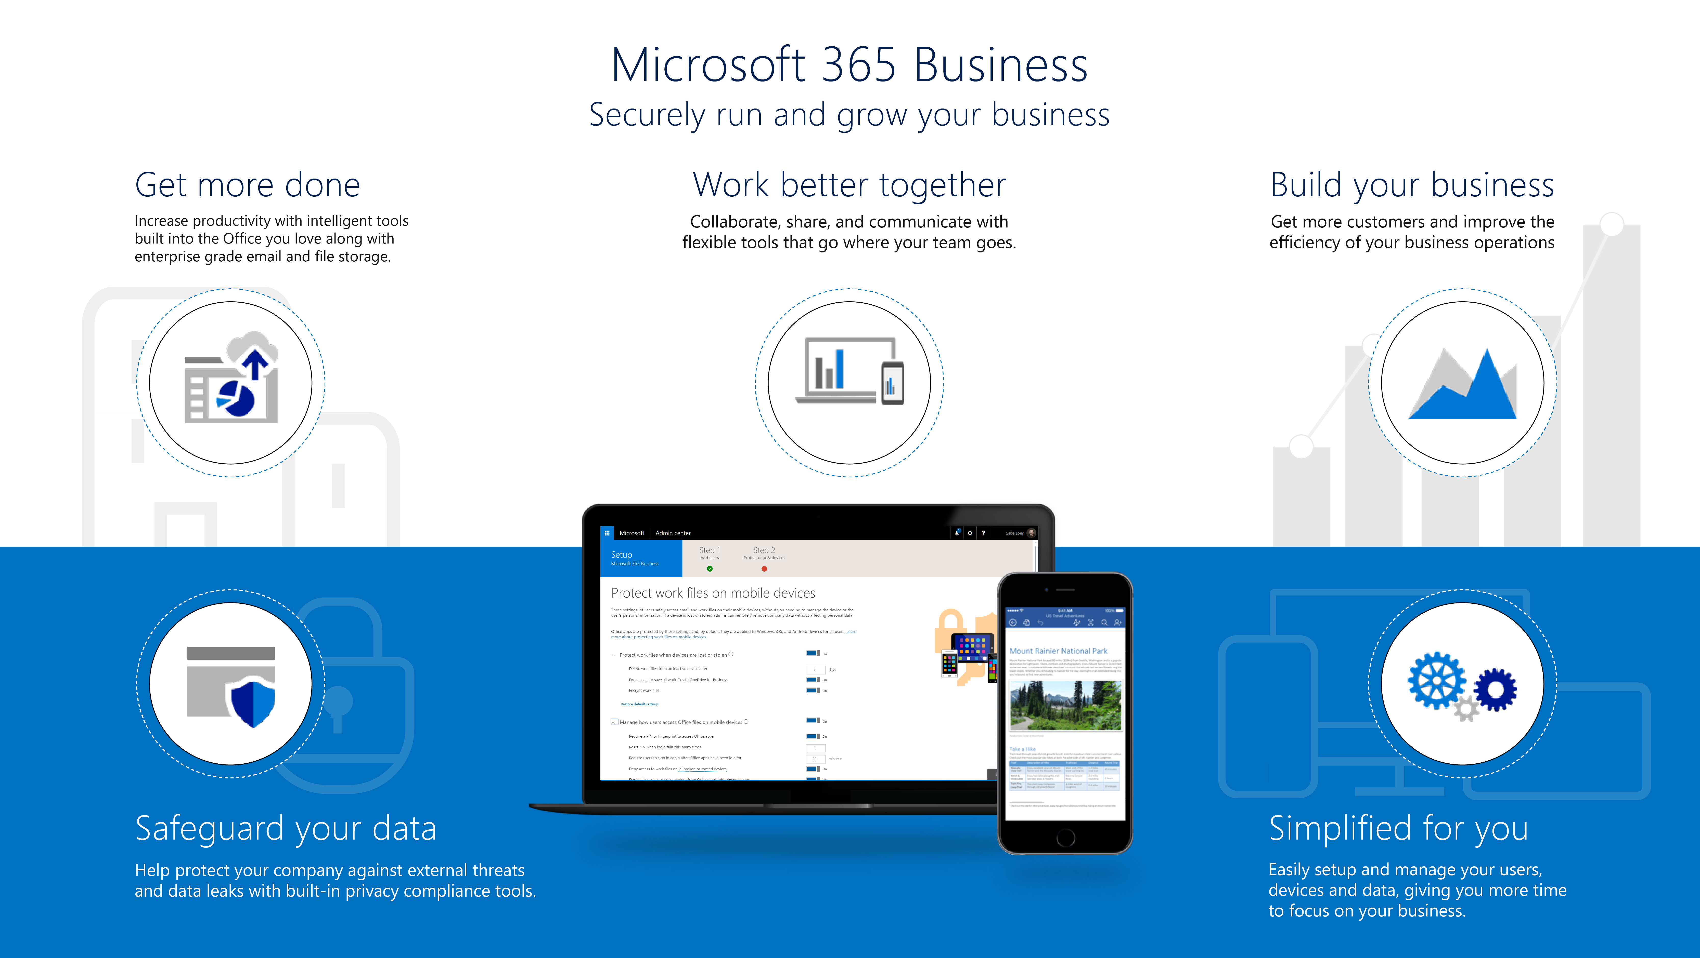
Microsoft 365 Business Premium Securely run and grow your business
Microsoft 365 - Securely run and grow your business
Notes:
Now before we begin, let us take a minute to see what we’re going to cover today in Microsoft 365 Business Premium:
You’re going to Learn how you can get more done with Intelligent tools built into the Office you love along with enterprise grade email and file storage
We’ll show you how you can work better together with the new Microsoft Teams and how you can collaborate as a group with your co-workers, customers and suppliers.
Microsoft 365 Business Premium also includes specific business apps designed to help build the business like Bookings and Outlook Customer Manager for example. These help you get more customers and improve the efficiency of your business operations​
We’ll also show how Microsoft 365 Business Premium safeguards your data by helping protect your company against external threats like phishing and malicious emails. It also includes features to help you protect sensitive information like Social Security numbers, credit card information etc from leaving the organization
Finally, we’ll show you how you can easily enable all of these features along with simplifying device setup so you can unlock the value of your Microsoft 365 Business Premium subscription faster
let’s take a deeper dive in to what you get with your Microsoft 365 Business Premium Subscription

Slide 5
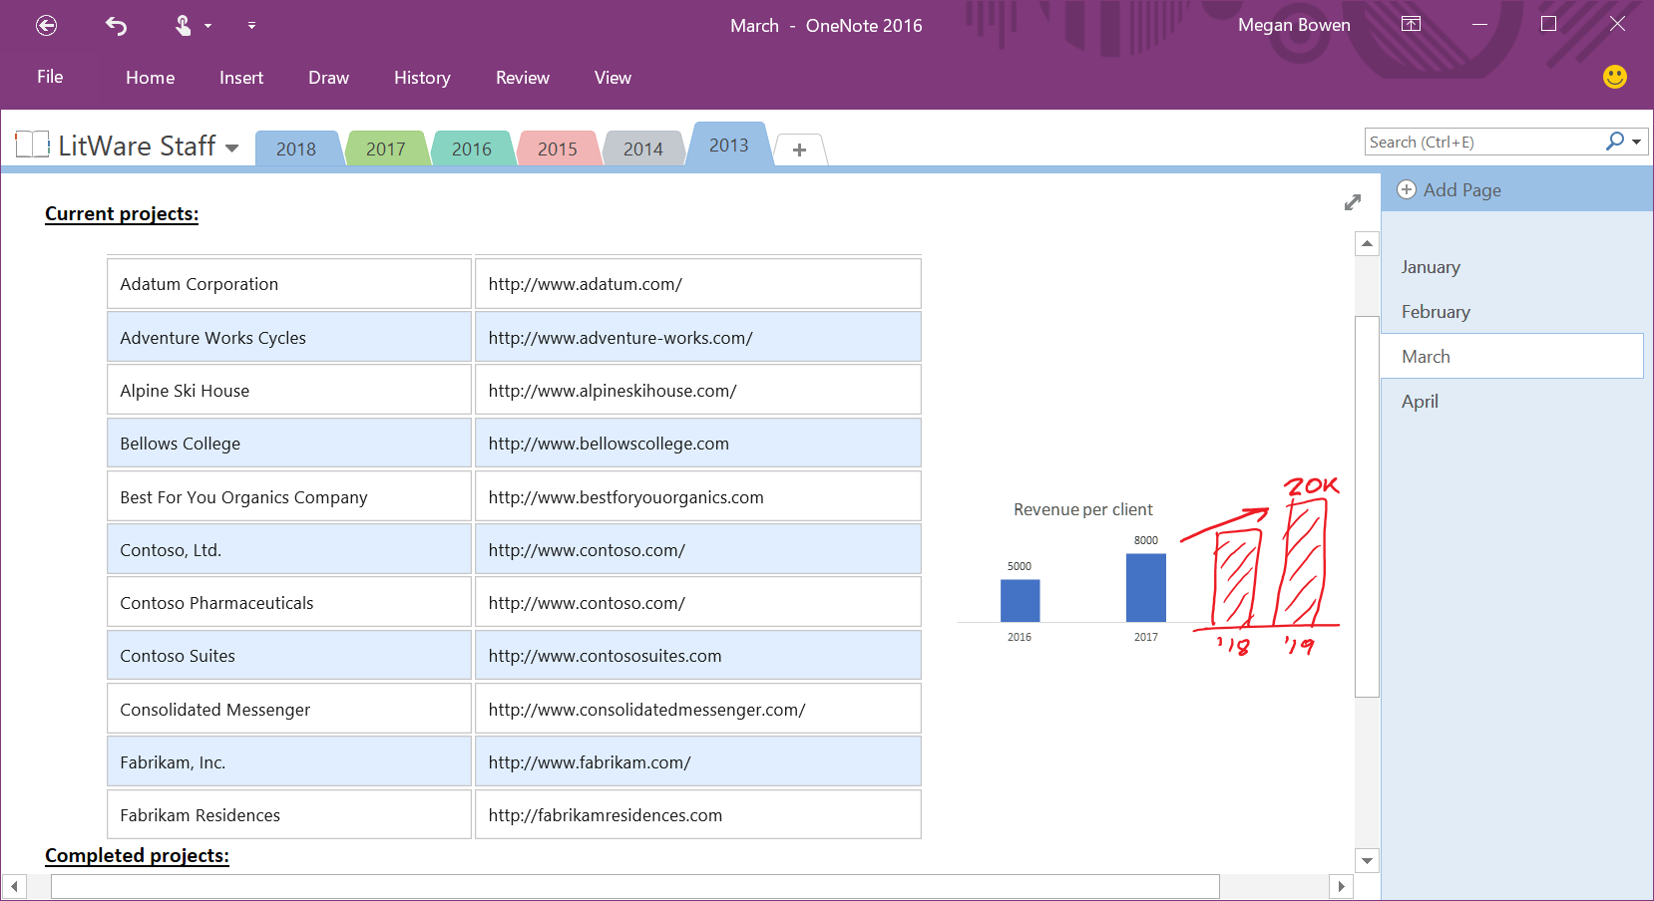
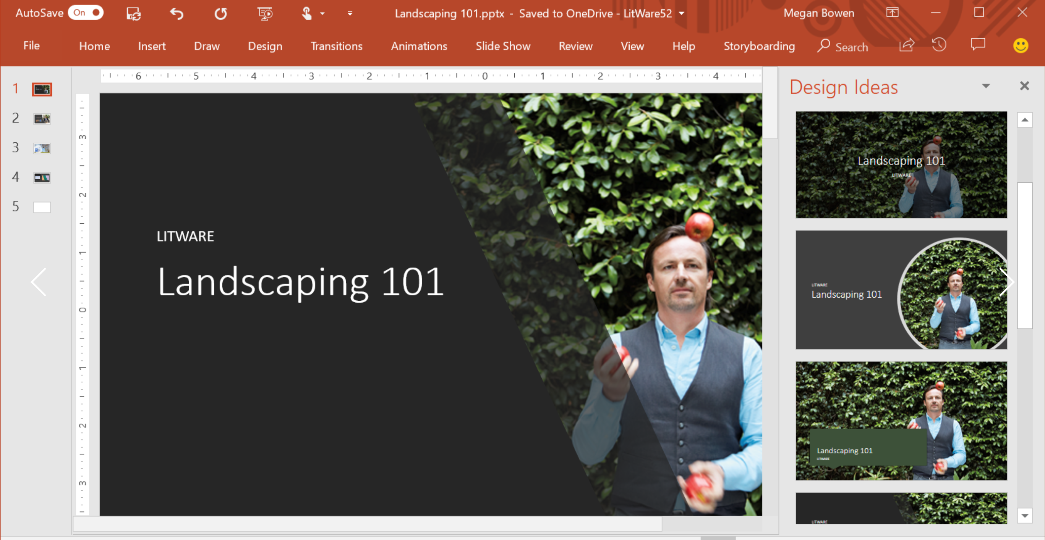
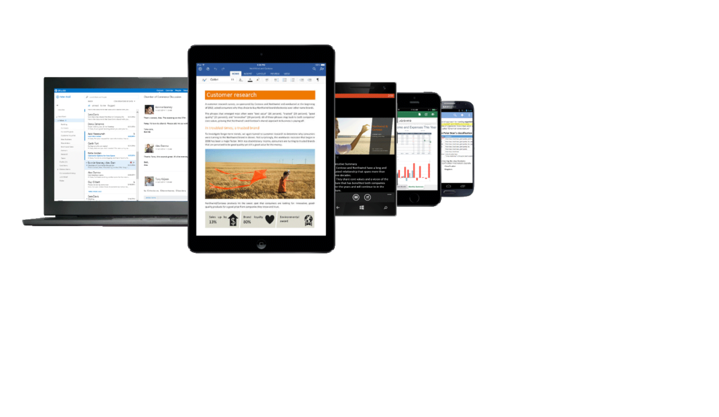
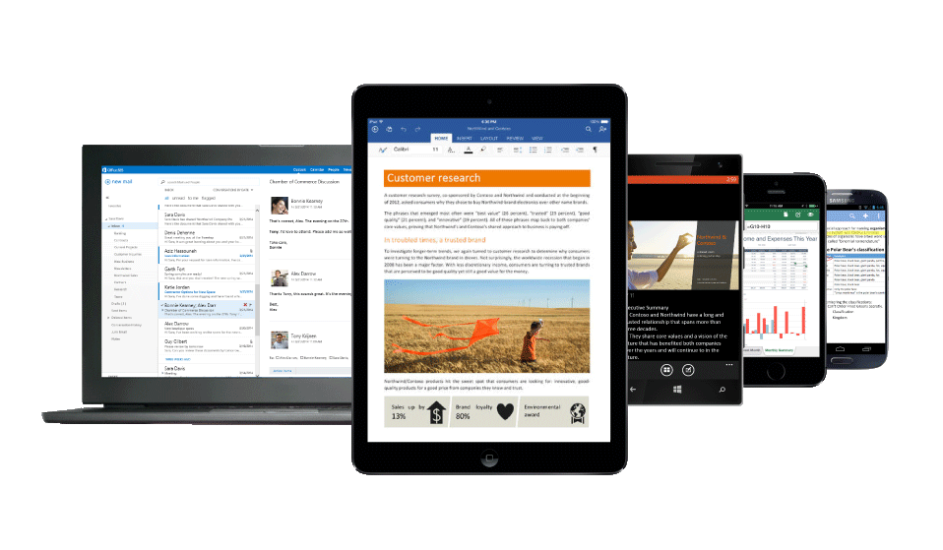
Get more done
Create your best work like a pro with intelligent tools​ built into the Office you love and are familiar with
Get work done on the go with enterprise grade email and calendaring features
Stay on top of all your work with access to all your files with online file storage
Work efficiently with integration to other apps and solutions you use daily​
Notes:
Let’s unpack what we mean by Get More Done.
With Microsoft 365 Business Premium you get enterprise grade email, File storage for documents, a hub for teamwork, and the Office apps all working together so you can increase your productivity and grow your business with confidence.
In Microsoft 365 Business Premium you get the latest Office apps that you love and are familiar with like Word, Excel, PowerPoint, OneNote and more. More importantly you get new features like intelligent recommendation tools. … like for Example Designer in PowerPoint - that can automatically recommend slide designs based on your content without you having to build the slide. It helps you create your best work like a pro saving you precious time and effort
You can also get work done on the go with enterprise grade email and calendaring features in Outlook. You get a 50 GB mailbox and you don’t have to worry about running out space in your mailbox.
You can also stay on top of your work with access to your files with Online file storage in OneDrive for Business. You get 1 TB of file storage and you can share your files from anywhere and any device whether at work, at home or on the go.

Slide 6
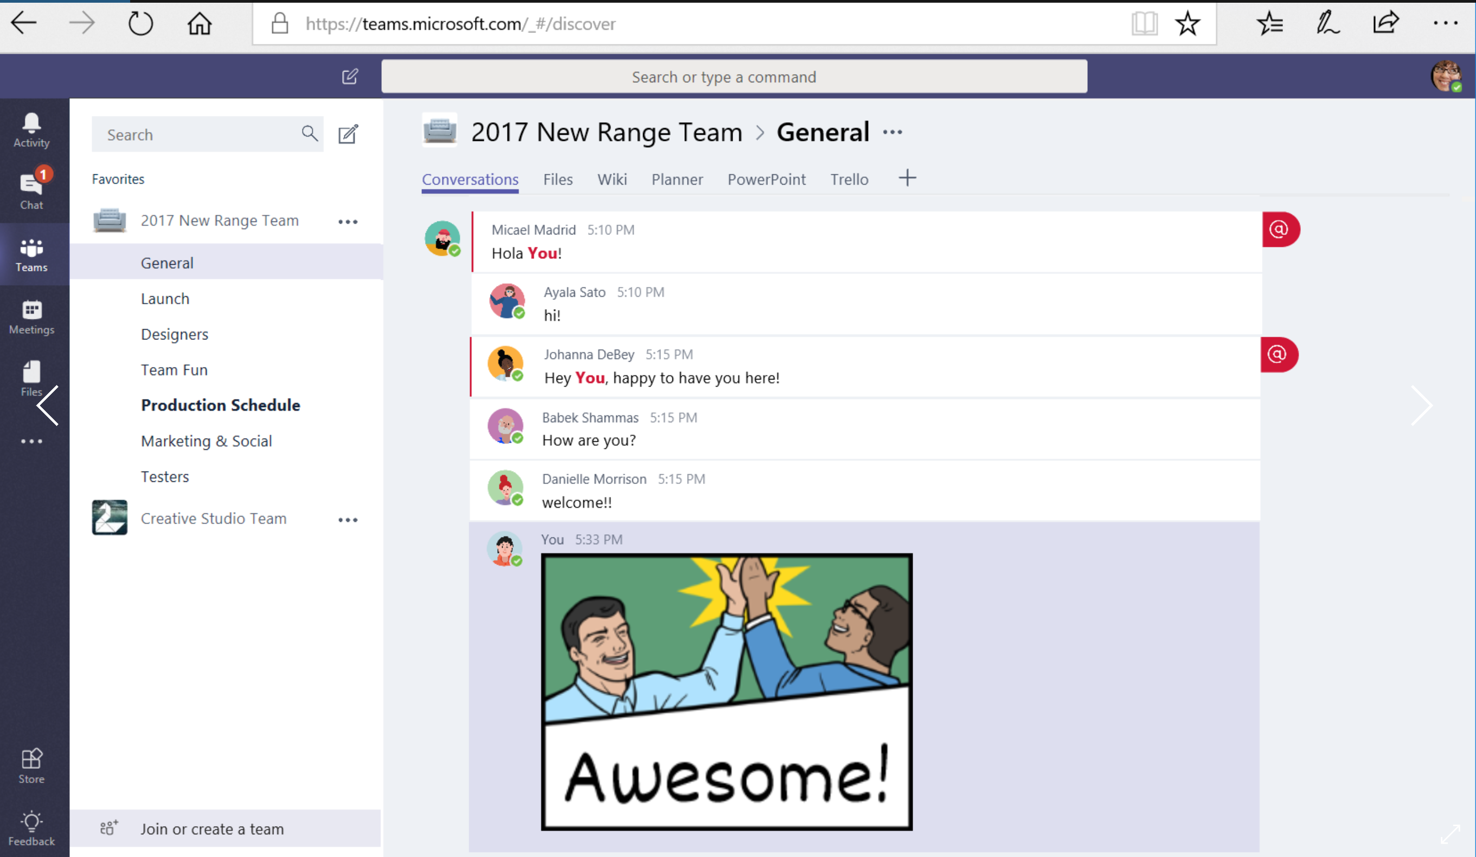
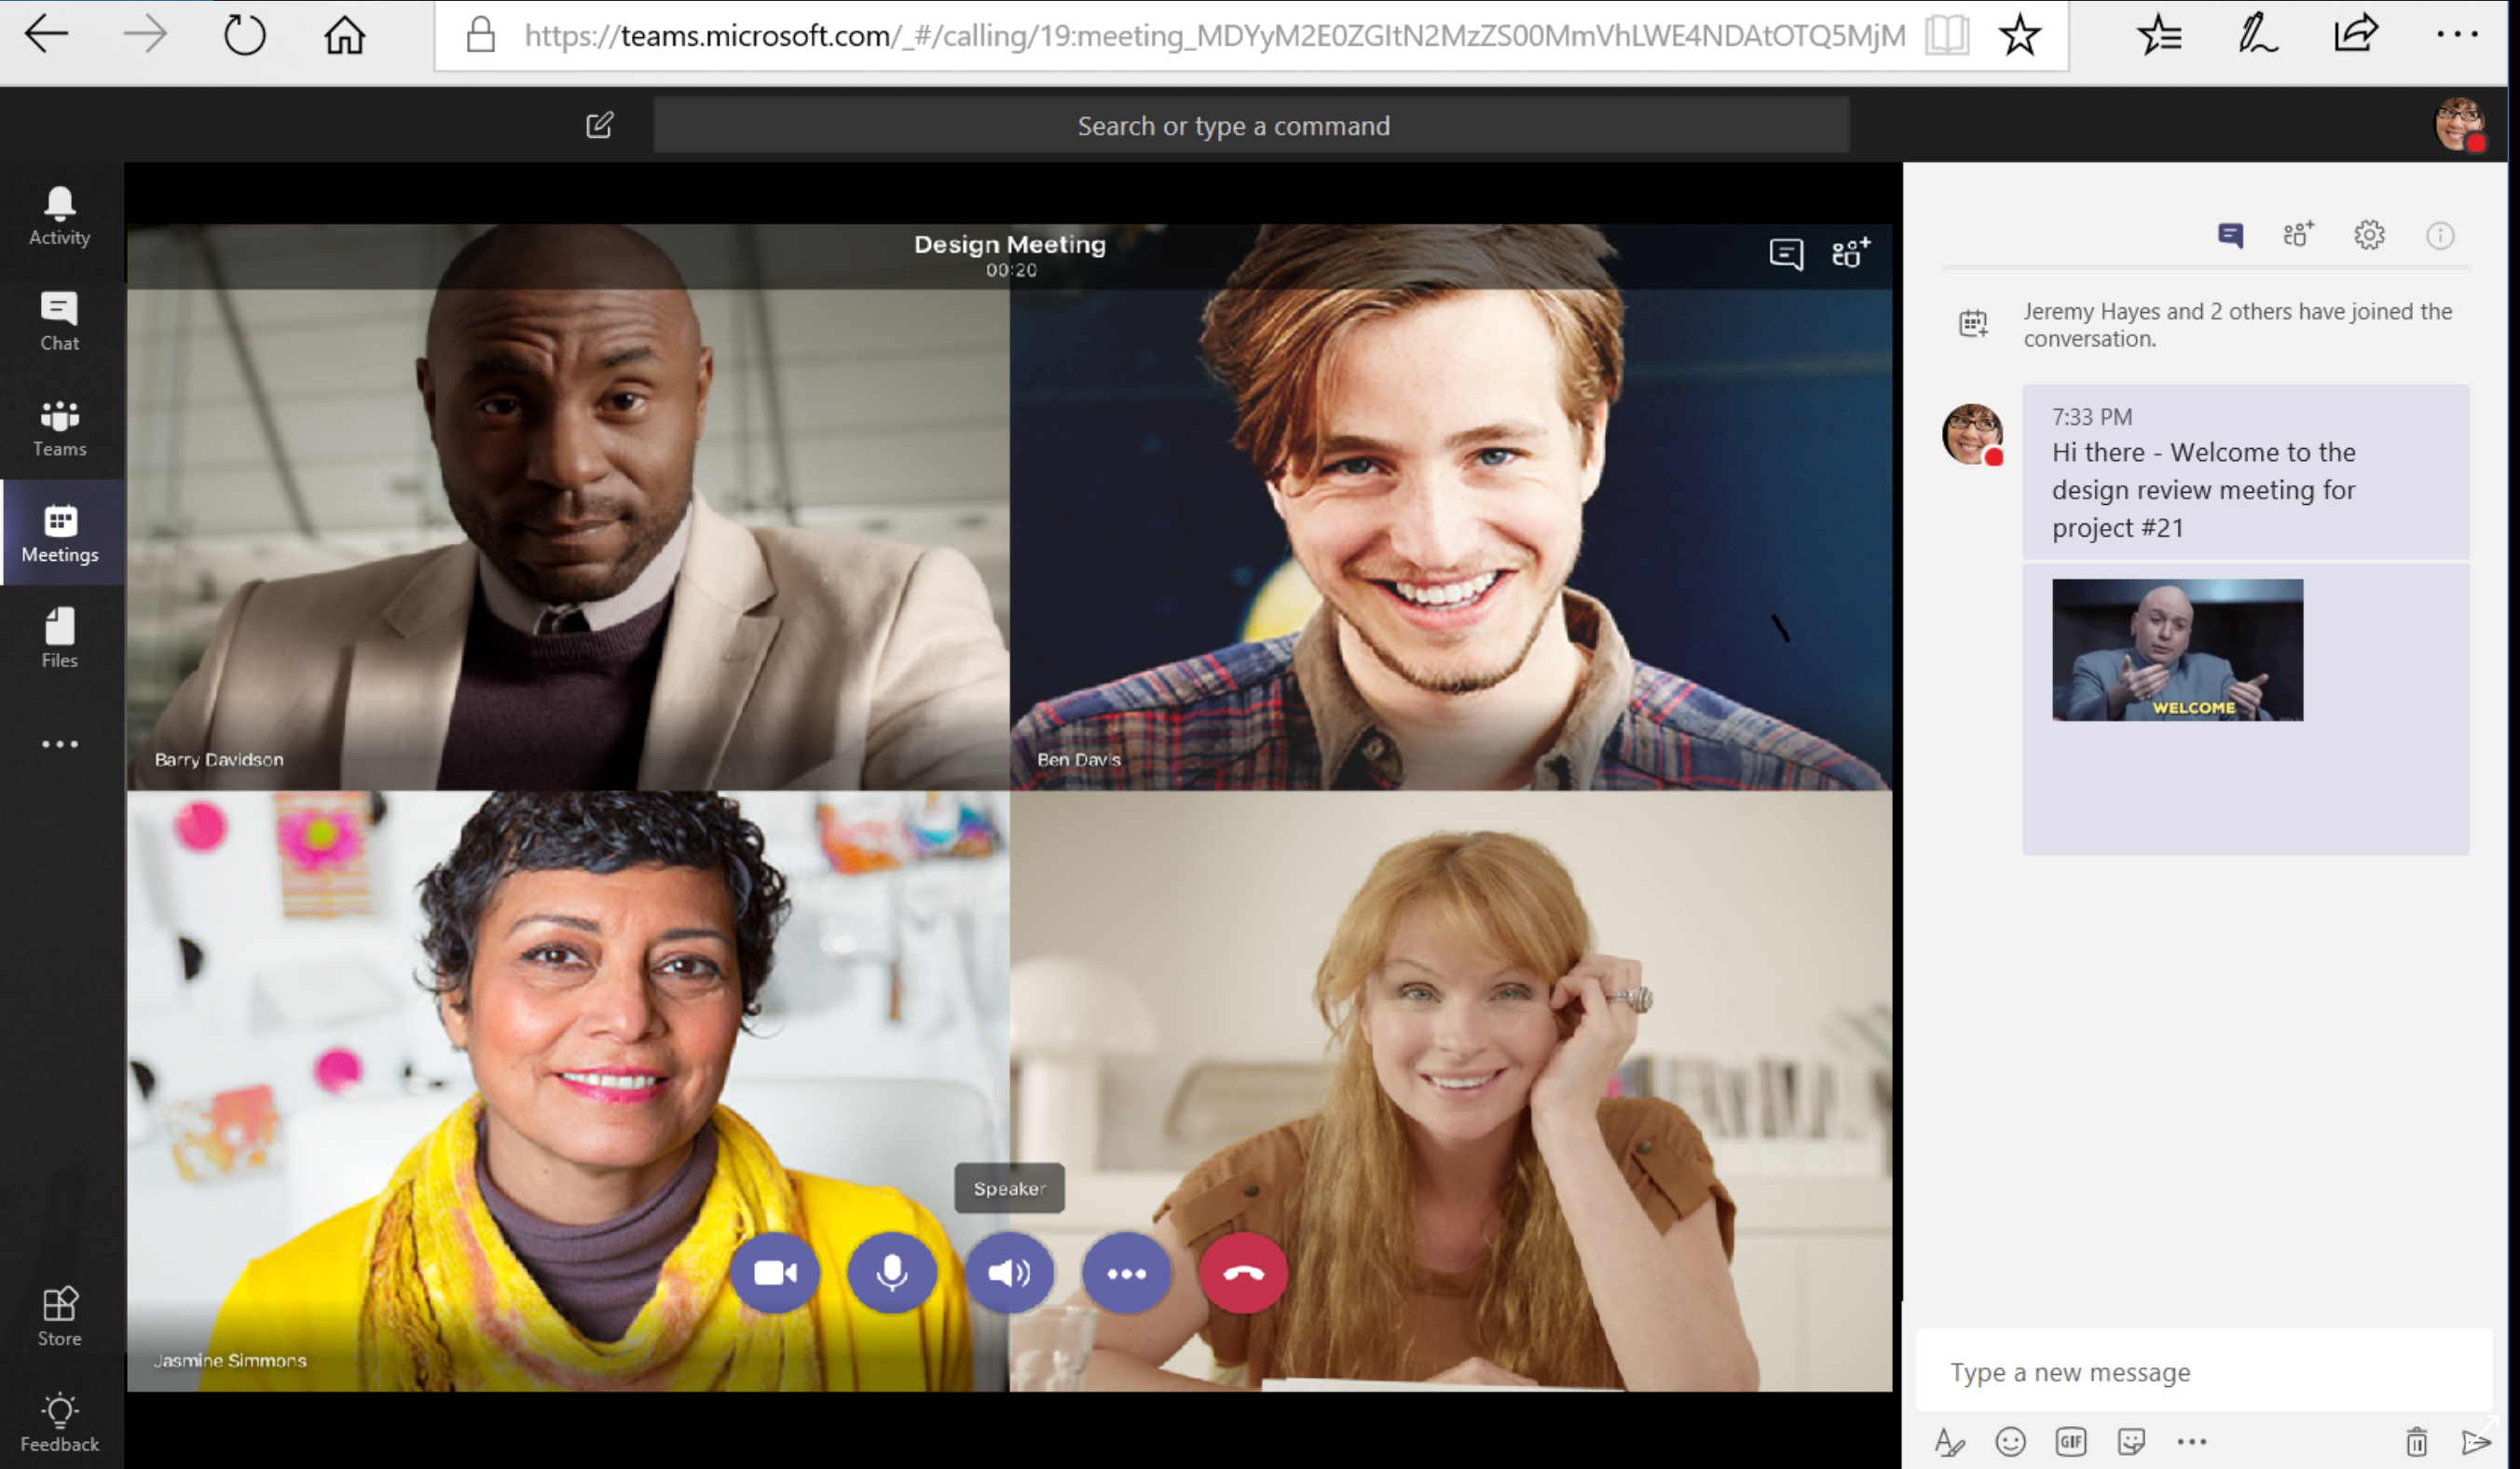
Work better together
Bring together teams and resources, all in one place​
Connect with customers, coworkers, and suppliers
Work anywhere from any device​
Host online meetings to get work done in real-time​
Notes:
With Microsoft 365 Business Premium you can Work Better Together through the power of Microsoft Teams.
We’ll go into more detail on this in the demo but Microsoft Teams is a hub for teamwork that brings together all your team’s chats, meetings, files, and apps making it easier for you to collaborate and keep track of group projects involving your co-workers, customers and suppliers.
With state of the art co-authoring capabilities, you can Share and edit your documents in real-time with your team from anywhere any device
You can even Host online meetings in Teams to get work done in real-time
With one click, anyone inside or outside your company can join your online meeting
You can even Record meetings and use the whiteboard, to draw out ideas and work together to solve challenges.

Slide 7
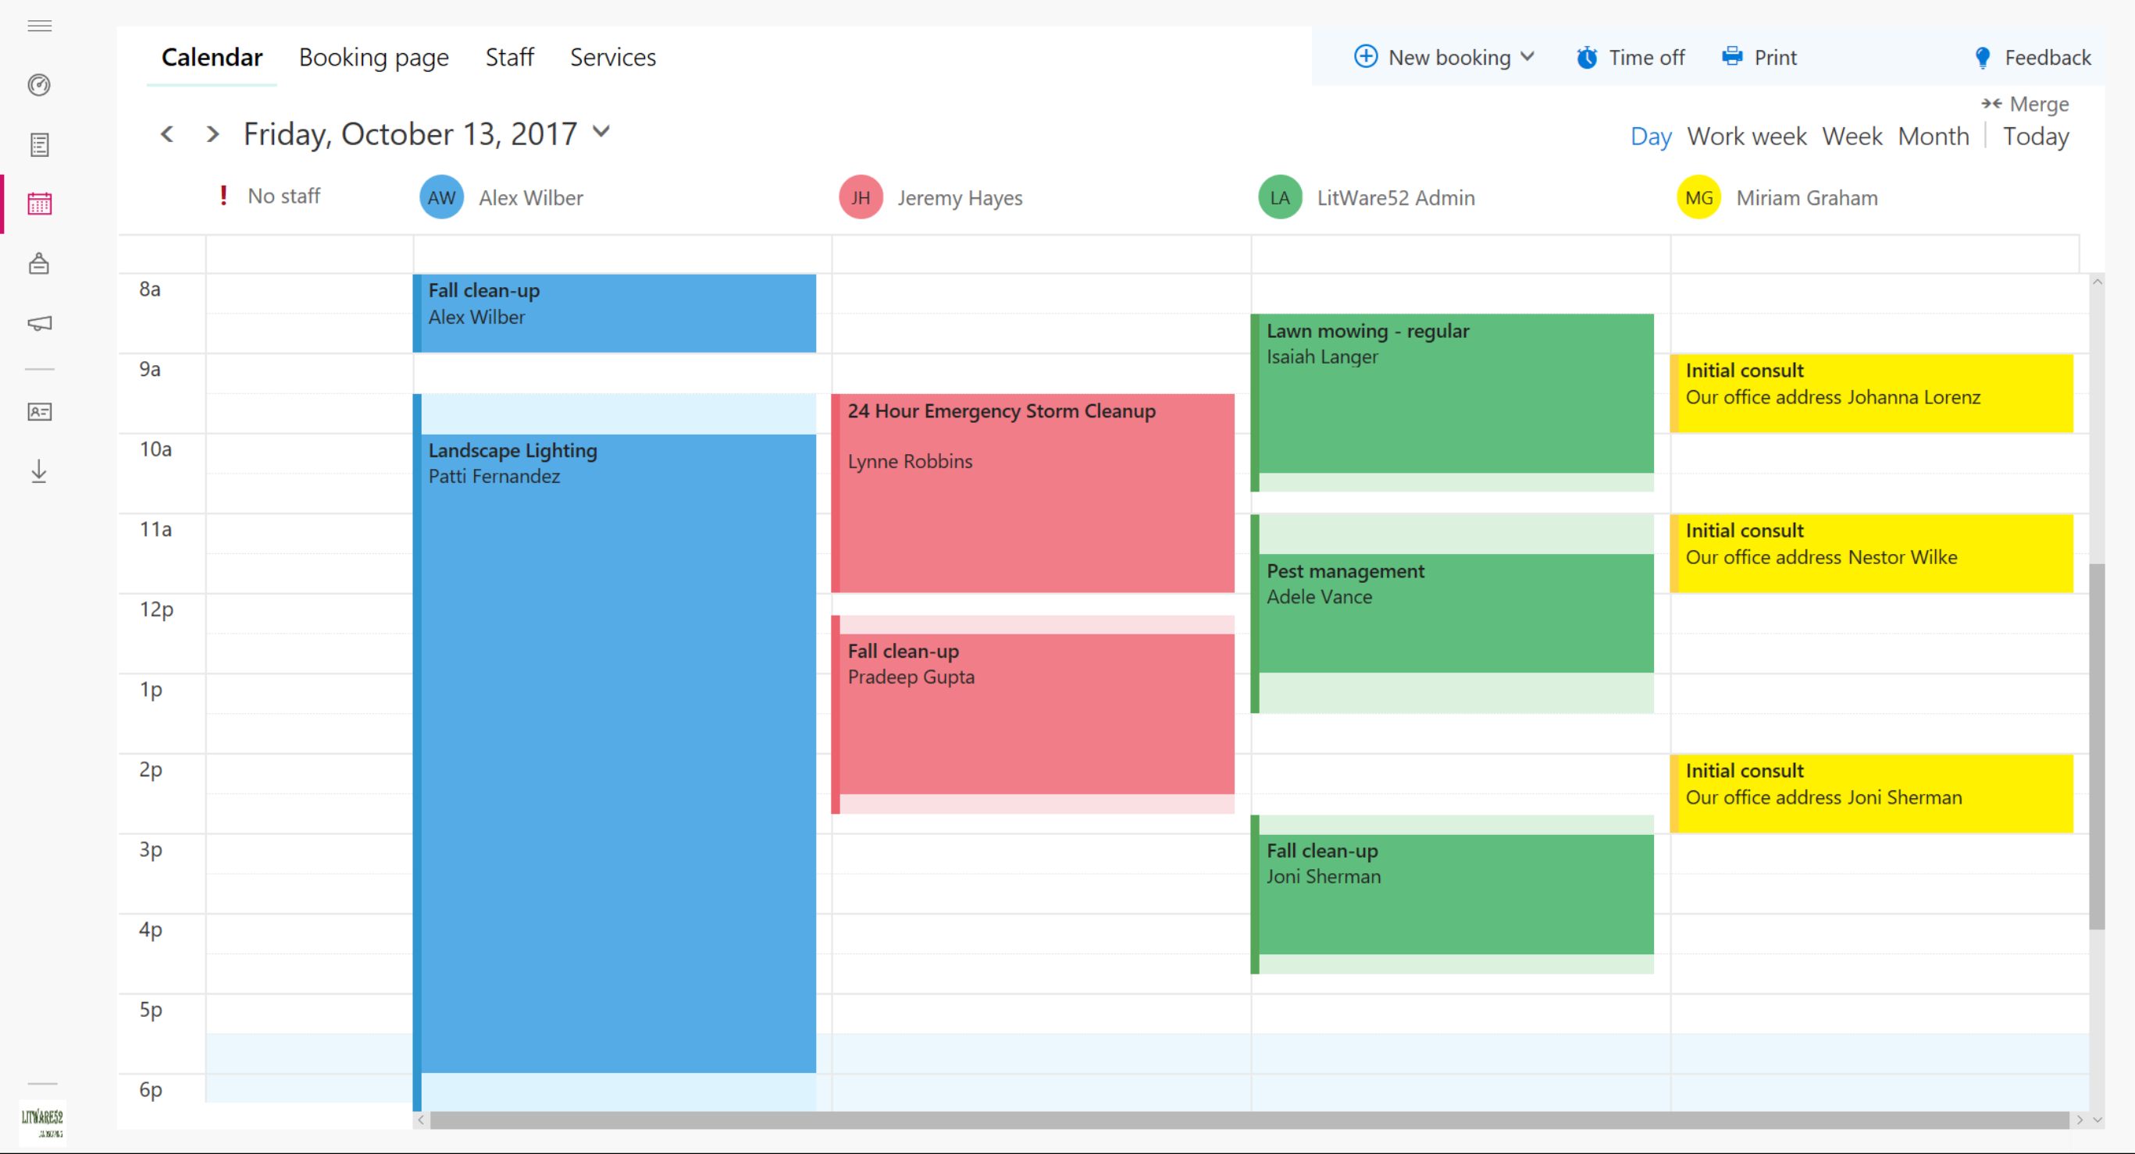
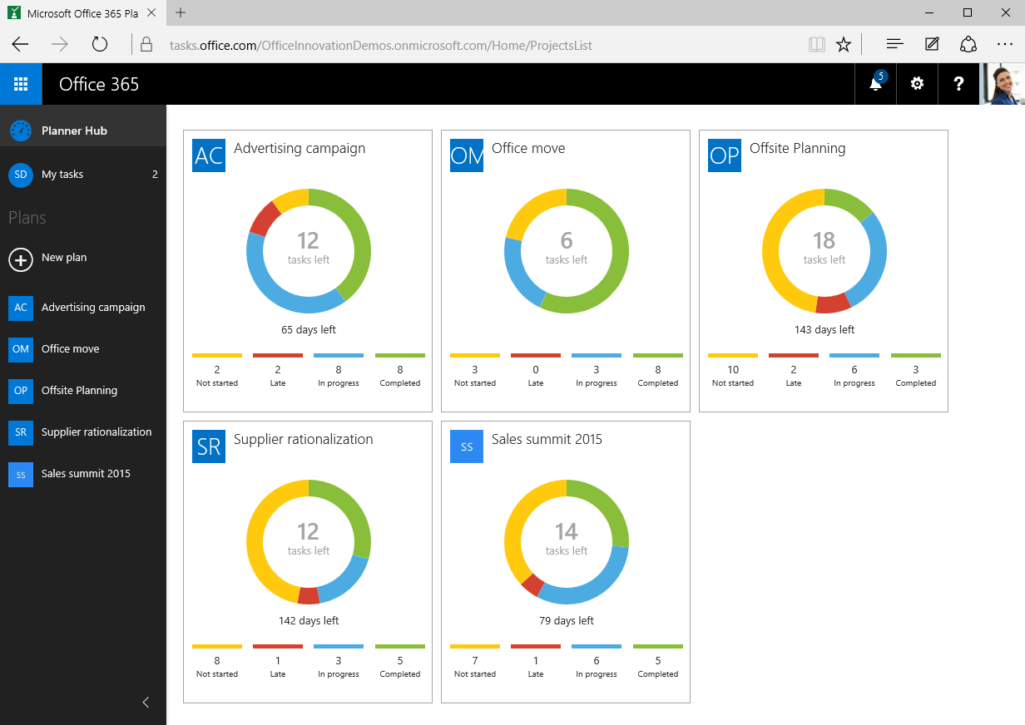
Build your business
Build stronger customer relationships with Outlook Customer Manager
Schedule appointments with your teams and work with Bookings
Optimize your business planning with Planner
Notes:
In Microsoft 365 Business Premium we have specific apps designed to help you Build your business.
For example You can track customer interactions and grow relationships with Outlook Customer Manager. You can view customer details, history and track deals in progress within Outlook
Apps like Bookings help you simplify the process of scheduling and managing customer appointments. It has convenient web-based scheduling that allows your customers to self-schedule appointments with you.
Furthermore, apps like Planner make it easy for your team to create new project plans, organize tasks, and get updates on progress.

Slide 8
Safeguard your business
Taking a layered approach to security
Protection from threats
Protection from data leaks
Control
data access
Notes:
Apart from enabling all of these amazing productivity and collaboration features, M365 Business Premium gives you peace of mind by safeguarding your business. It helps protect your company against external threats and data leak of sensitive business information
And it does this by taking a layered approach to security. You get:
First, you get Protection from sophisticated threats hidden in email attachments and links, and get cutting-edge defenses against zero-day threats, ransomware, and other advanced malware attempts.
Second, you get Protection from data leaks helping you prevent sensitive information like SSNs and customer credit card numbers from being shared outside your business
3rd you get to control and manage access to information. With M365 Business Premium, you can control who has access to company information by applying restrictions like Do not Copy and Do Not Forward. You can Enjoy peace of mind by remotely wiping business data on lost or stolen devices without affecting personal information

Slide 9
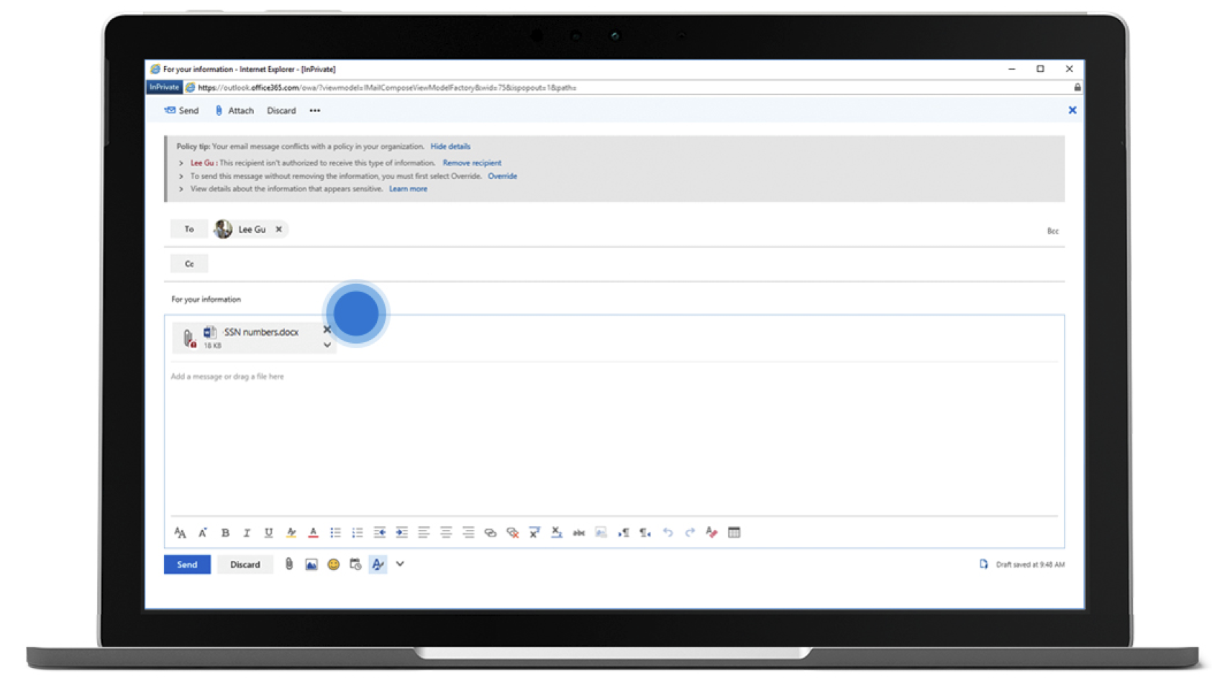
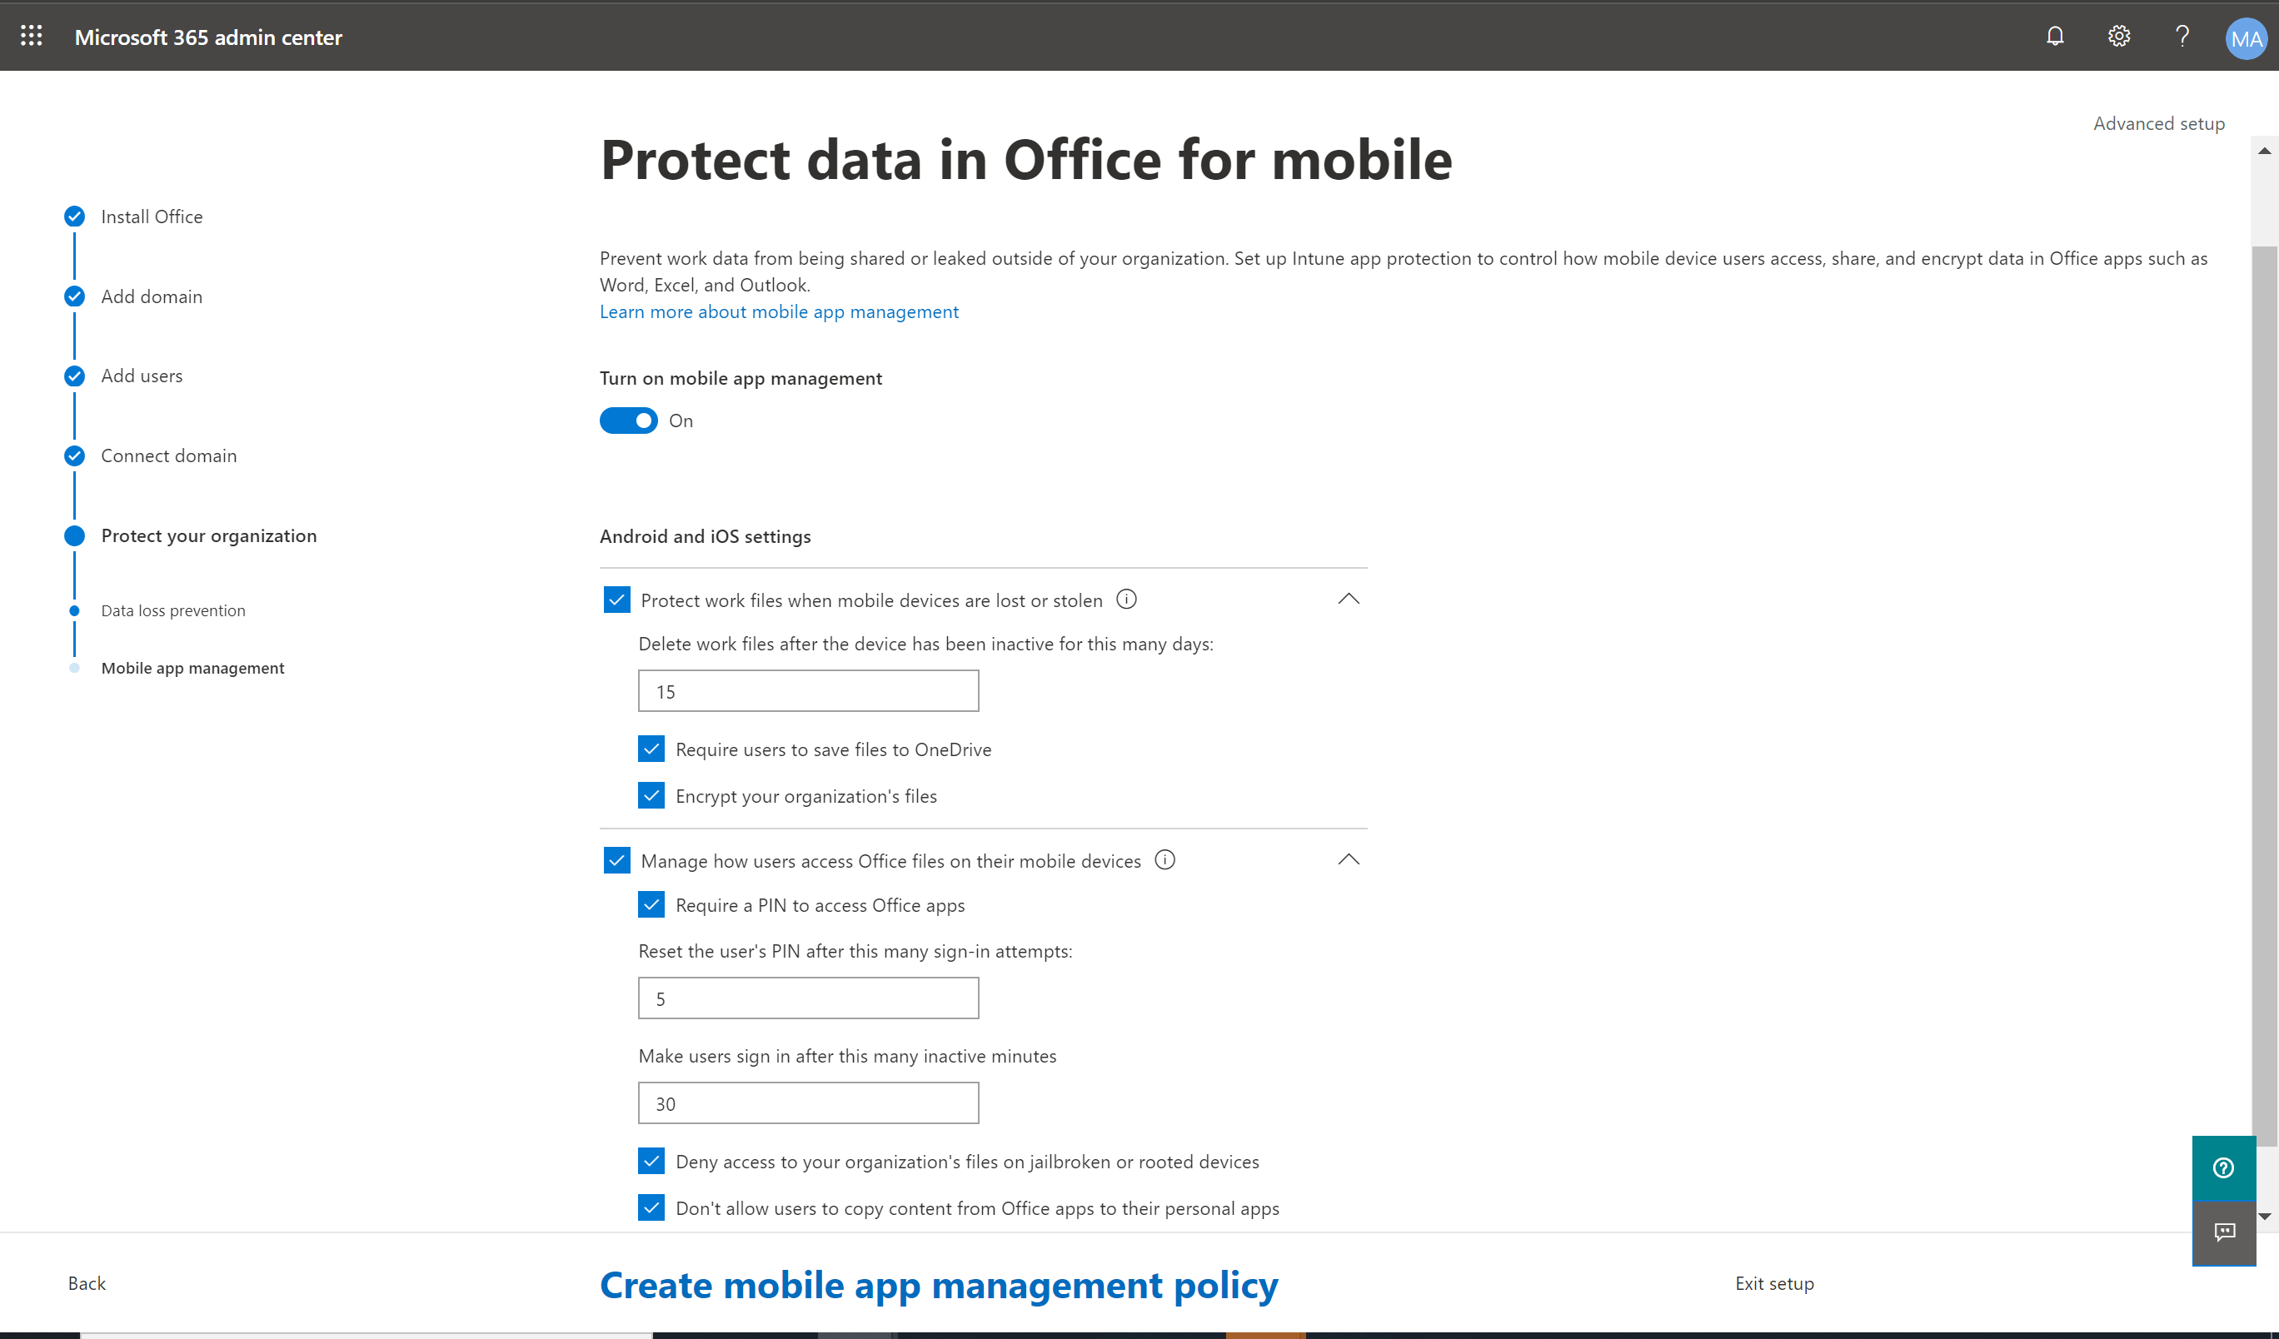
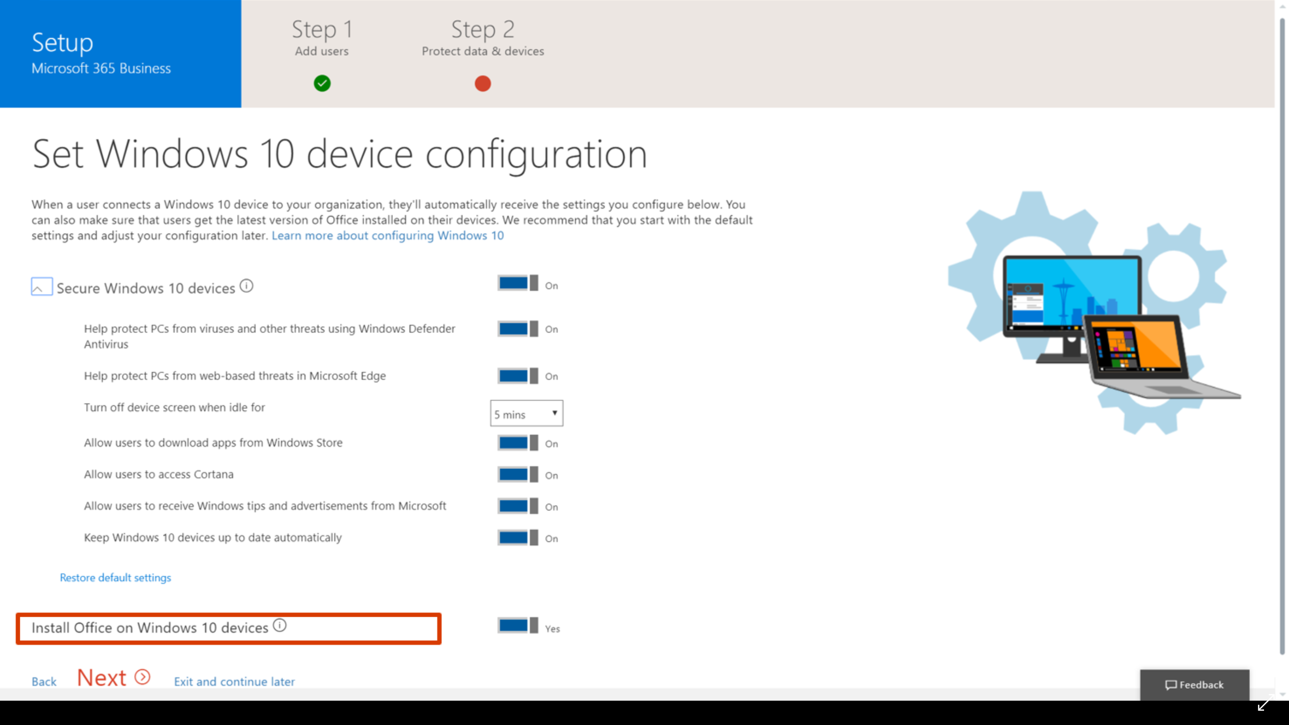
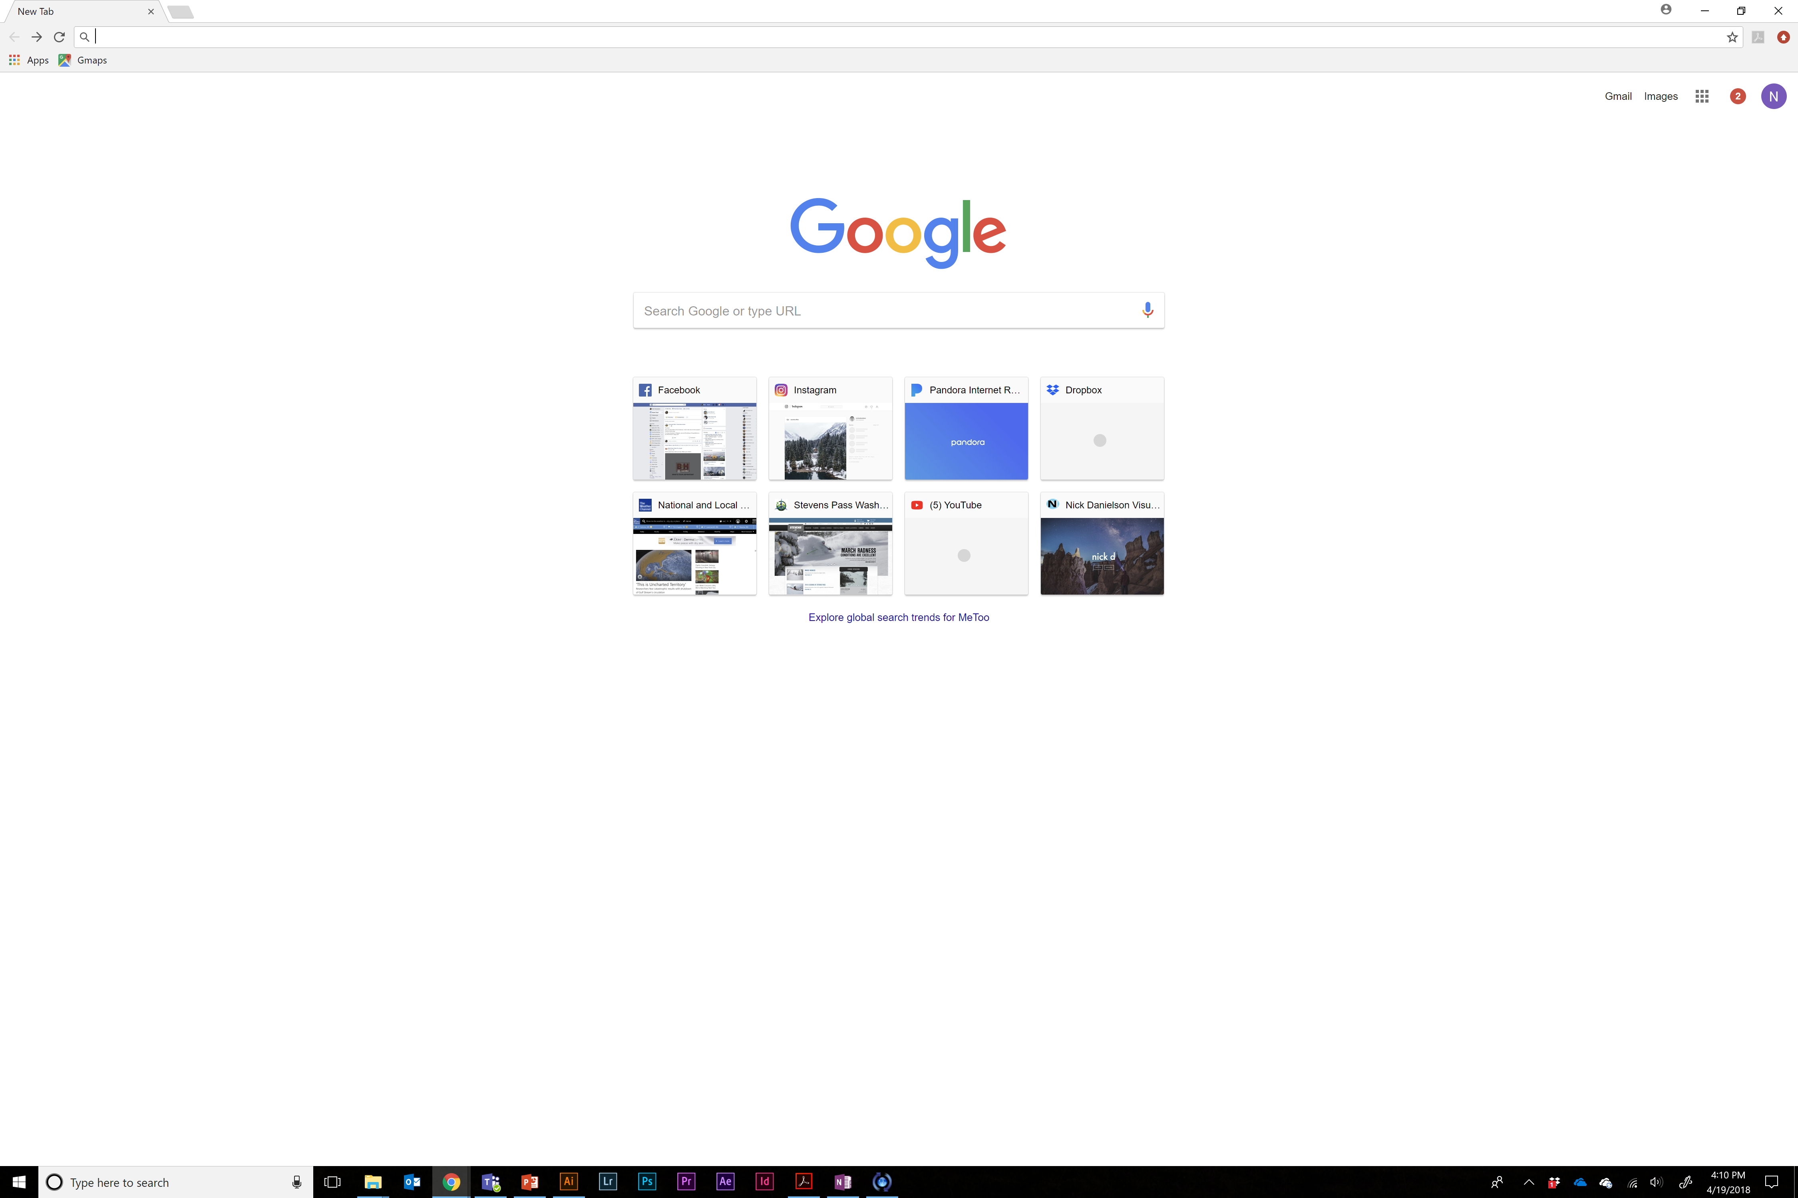
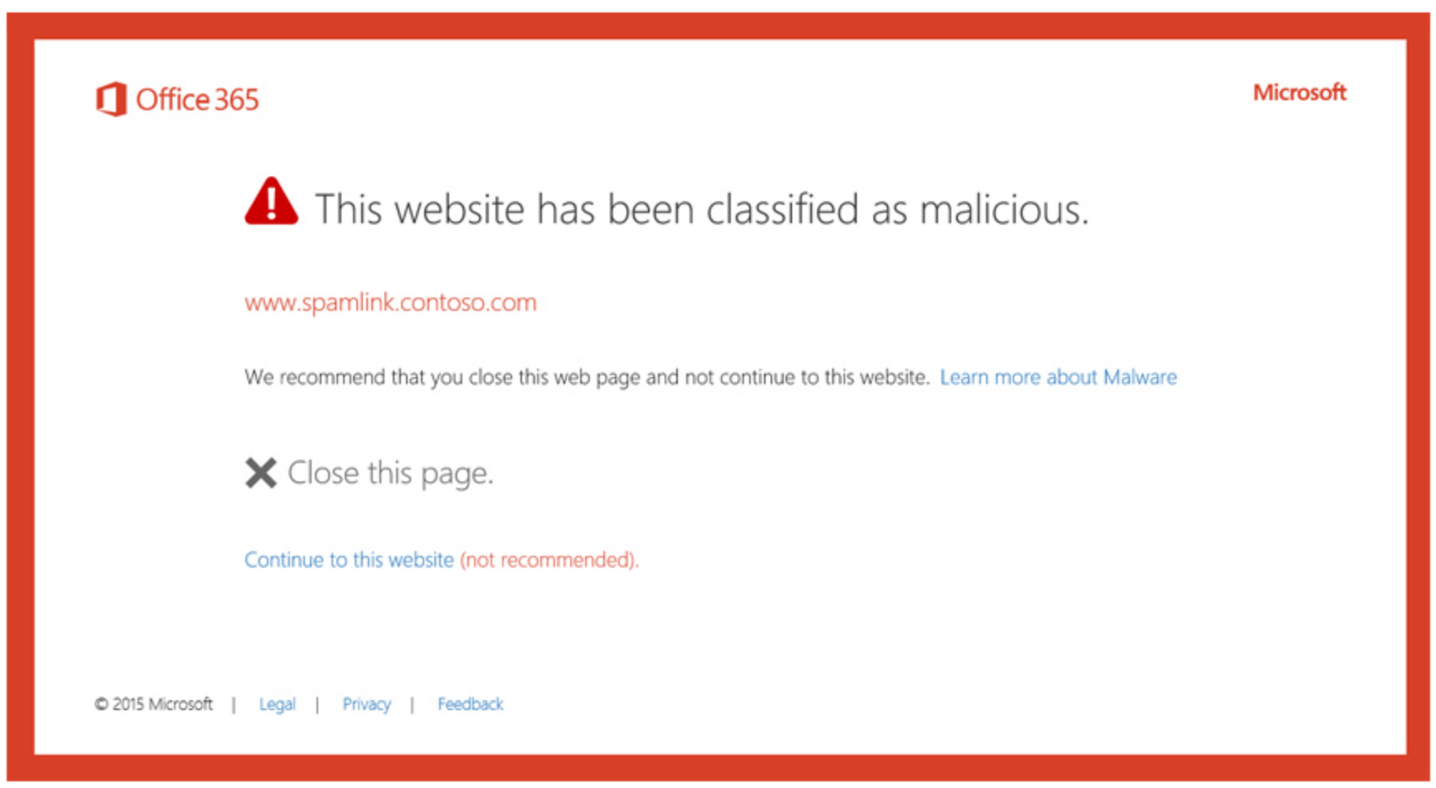
Simplified for you
Easily set up devices​
Manage users devices and data
Seamlessly integrate security
Notes:
It is easy to look at all these features and wonder how complex it would be to enable these functionalities. In Microsoft 365 Business Premium, we have made it Easy to setup and manage your users, devices, and data, giving you time back.
We’ll show you more in the demo but you can easily set policies quickly onboard a new PC or to refresh an existing PC with automatic Windows 10 setup and configuration helping you get value of your Microsoft 365 Business Premium Subscription faster
I know we’ve talked a lot about Microsoft 365 Business Premium. Let’s head to the demo so you can see it in action

Slide 10
DEMO

Slide 11
Microsoft 365 – One subscription for Productivity + Security + Device Management
Device Management
Archiving
Data Loss Prevention
Device & App Management ,,,across PCs, Macs, iOS & Android
Email Threat Protection
Information Protection
Archiving + Litigation Hold
Email Filtering
3rd party solutions
(bought separately, expensive & hard to integrate)
Data Loss Prevention
Device Anti Virus
Email + Device Threat Protection
Online Chat & Meetings
Email Filtering
Windows Defender AV
Microsoft 365 (all included, seamlessly integrated)
Storage
Teams
1 TB File Storage
Email
50 GB Cloud Email
Productivity Software
Office (Word, PowerPoint, Excel, Outlook, OneNote, Access)
Windows Virtual Desktop
Notes:
As you can see with all that we’ve showed you, Microsoft 365 Business Premium is a single subscription that provides you with collaboration, security and easy device management. Now, you can enable these capabilities by purchasing 3rd party services separately but those would be expensive and not mention the integration would be clunky. Microsoft 365 Business Premium costs $20 per user month and the integration of features are seamless, giving your users a delightful experience.

Slide 12
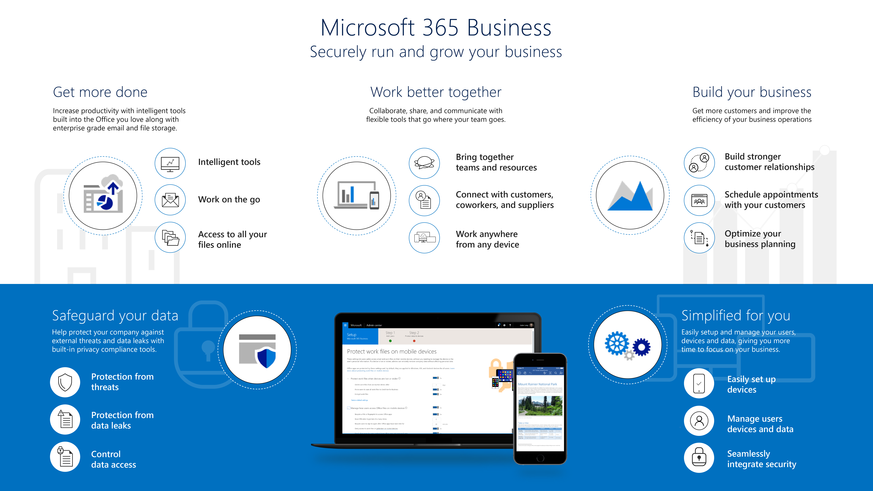
Microsoft 365 - Securely run and grow your business
Notes:
To conclude, let’s just recap what we covered in Microsoft 365 Business Premium:
You saw how you can get more done with Intelligent tools built into the Office you love along with enterprise grade email and file storage
We showed how you can work better together with the new Microsoft Teams and how you can collaborate as a group with your co-workers, customers and suppliers.
We showed you specific business apps designed to help grow the business like Bookings and Outlook Customer Manager ​
We also showed how Microsoft 365 Business Premium safeguards your business by helping protect your company against external threats like phishing and malicious emails. And features to help you protect sensitive information like Social security numbers, Credit card information etc from leaving the organization
Finally, we showed you how you can easily enable all of these features along with simplifying device setup so you can unlock the value of your Microsoft 365 Business Premium subscription faster

Slide 13
Thank you

